Slide 1

DriverPass
System Analysis
John O’Brien
Notes:
[No speaker notes required for this slide.]

Slide 2

System Requirements
Functional Requirements:
The system shall validate user credentials to ensure account security and access permissions.
The system shall allow students to book and schedule available driving lesson appointments.
Notes:
These are just two examples of requirements we have created for them.
These have been selected as examples of our focus on security and functionality.

Slide 3
System Requirements
Nonfunctional Requirements:
The system shall run within standard desktop and mobile browsers.
The system shall encrypt both data at rest and data in-transit following industry standard best practices.
Notes:
Again, these are just a couple of nonfunctional requirements to communicate our vision to our client.
Our vision for this application is excellent execution without sacrificing security, thus hitting those same two points on this slide.

Slide 4
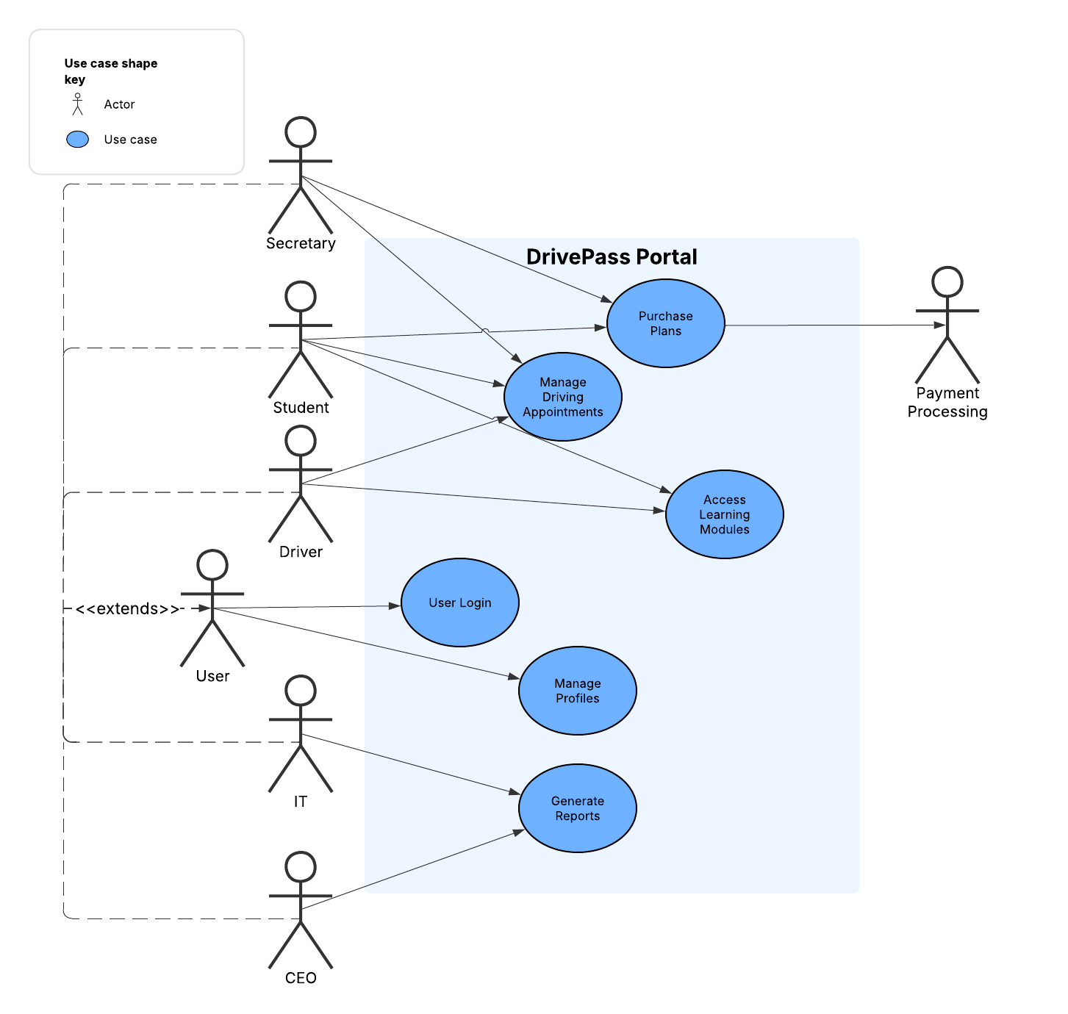
Use Case Diagram
[Insert your use case diagram here.]
Notes:
[Explain your diagram. Who are the different actors in the system? What are the different use cases? How did you account for DriverPass’s needs in your design? In your explanation, keep your audience in mind. Avoid the use of terms like “actors” and “use cases” in your explanation.]
All Users need to be able to login, and need to be able to create, edit, or deactivate their profile as permitted by policy, procedure, and compliance.
Different user types are then segmented based on the students, the driving instructors, the secretary, IT staff, and the CEO. These each have access to only their needed systems.
Only IT and the CEO can generate reports. Only students and driving instructors can access the learning modules.
Only the secretary and students can access purchase and payment of plans.
Students, driving instructors, and the secretary all have access to the appointment scheduling system.

Slide 5
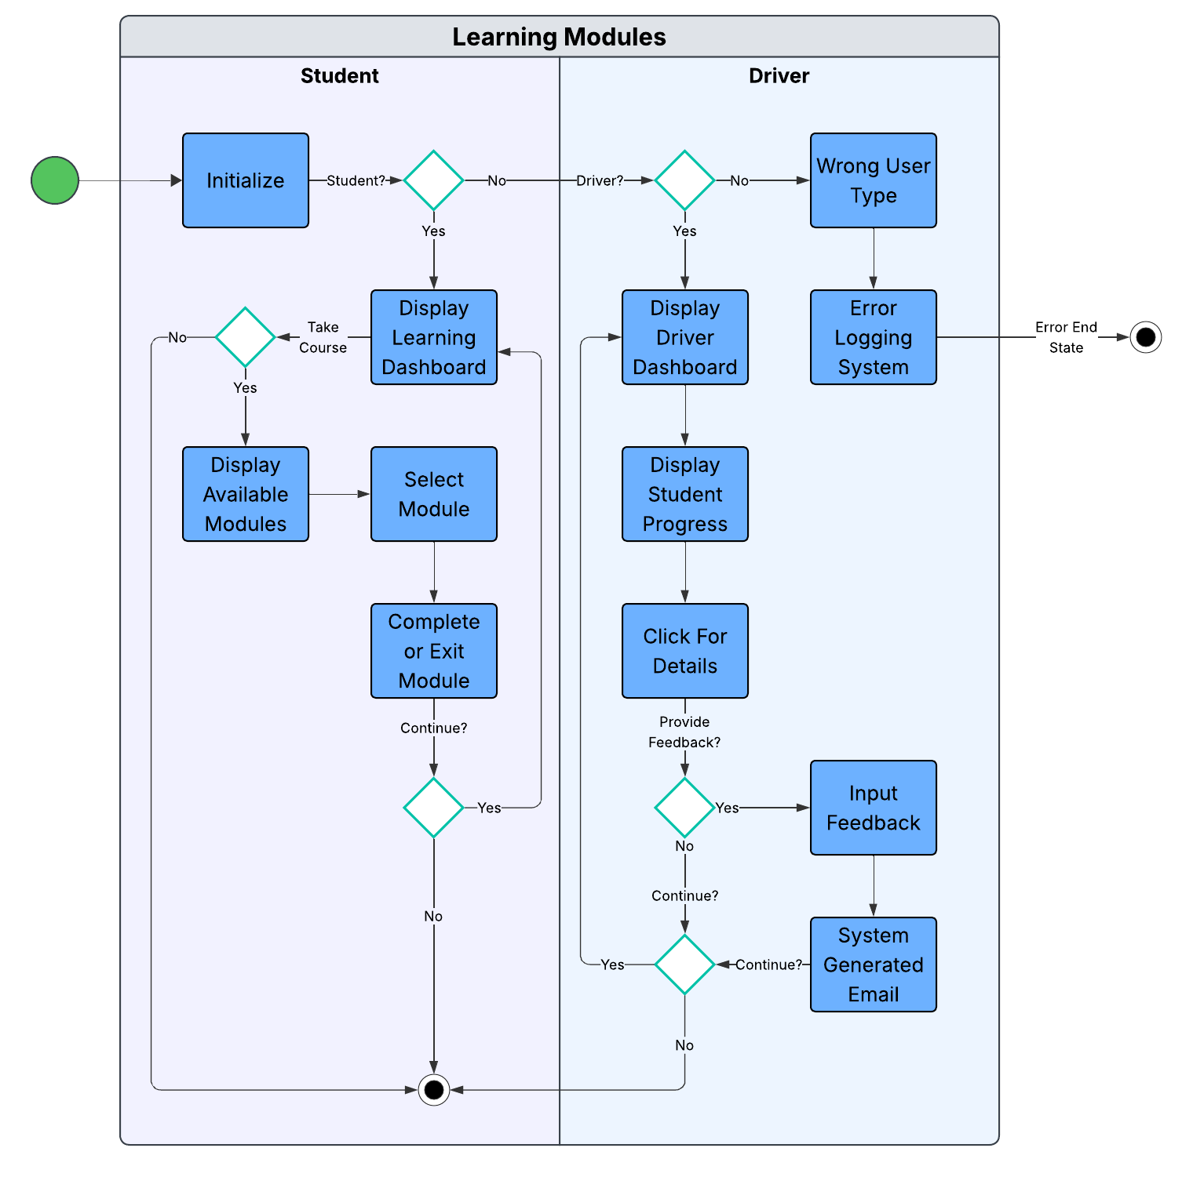
Activity
Diagram
Notes:
This is the activity diagram for the learning modules portion of the application. Here, we have two lanes for the two different user types that will be accessing this portion.
Students have a dashboard showing progress. If they wish to take a lesson, they can select any module and may complete it or return to that state later.
Instructors have a view containing all their students and can click through to view increased detail on any individual student.
Instructors may provide or update feedback on any individual module, on their driving lessons, or on the student as a whole.
The system will automatically notify the student of any new feedback.

Slide 6
Security
The database is encrypted at rest and all transmissions are encrypted in-transit.
User types are implemented to ensure users only have access to parts of the system as needed.
Automatic logs track when changes are made and by who.
The database can only be edited through the portal, preventing employees from changing data without it being logged.
Notes:
[How did you consider security in your design? In your explanation, keep your audience in mind by avoiding the use of technical terms.]
Security is viewed as a top priority.
The system is intended to be protected from outside attackers, from approved users, and even from employees.
There is a strong emphasis on ensuring compliance and maintaining records.
Payment information is never stored on the server and is handled through a third party payment processor.

Slide 7
System Limitations
The system can only be accessed while online.
The initial implementation of the system is only in English. This can be updated later.
The system is designed to not store payment information. Payment will be handled via a third-party payment processor.
The database has been designed to only be editable through the portal, for compliance and record integrity.
Notes:
Fairly straight forward here. The CEO requested offline access, which was viewed as unsecure. A compromise was reached where he could only generate reports online, but those reports could be exported.
Given the limited timeline, features like additional languages will need to be a future expansion of the design.
The other two system limitations are deliberate constraints placed on the system by design for security and compliance.

